Slide 1
# tag release 1
Instead of wire-frame I did this….because I don’t know how to use the wireframe software yet and I don’t want to hold us up as I learn how to use it!

Slide 2
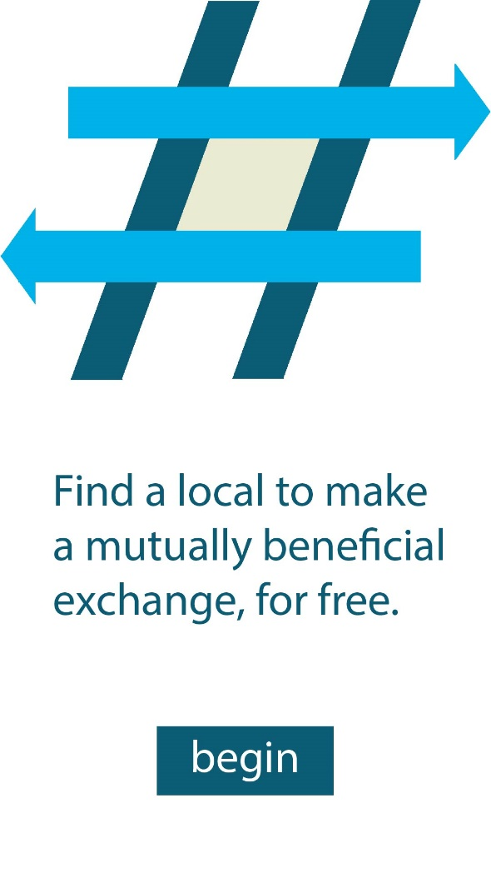
App opens up to this page, they click begin to take them to the next page
The “Splash Page”

Slide 3
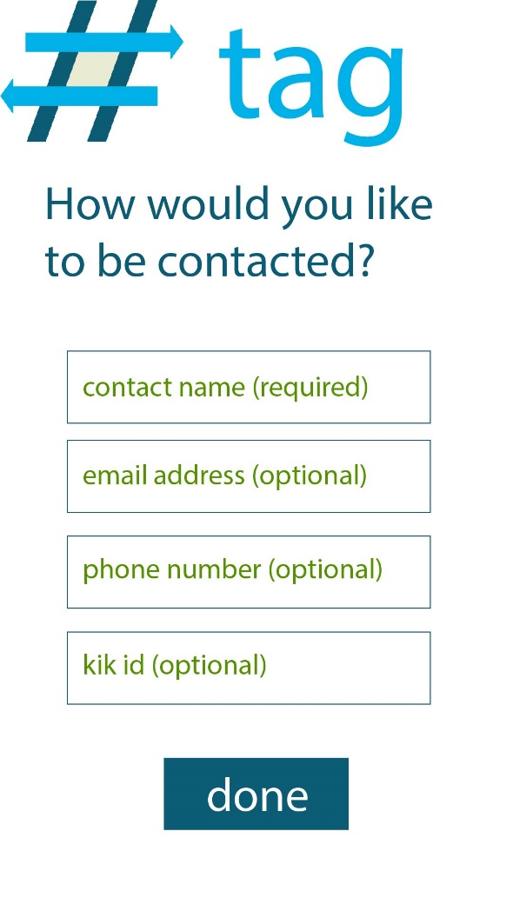
Here they can fill in their contact information to be stored locally in release 1 of the app. In release 2 we will save it on the cloud as well. They click done are sent to the next screen
The “Contact Input Page”

Slide 4
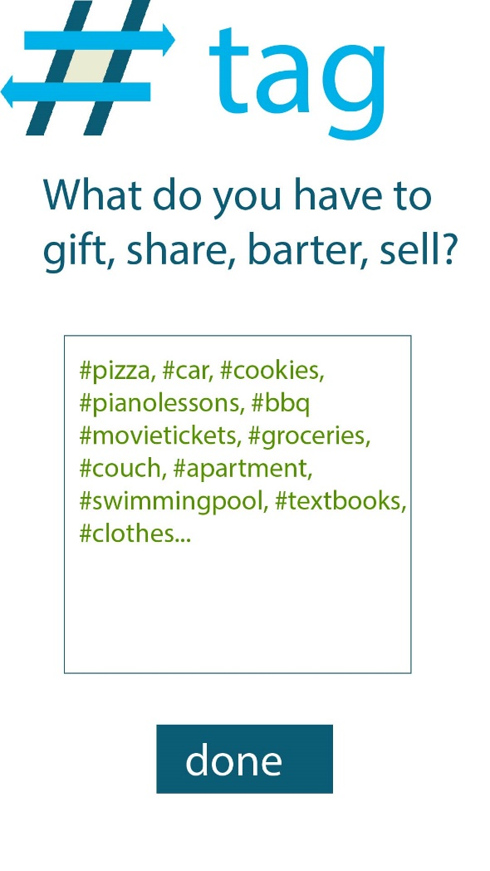
Here they can add #terms into a large textbox; also saved locally in release one. Uploaded to cloud in release 2. Clicking done takes them to the next screen.
The “Inventory Input Page”

Slide 5
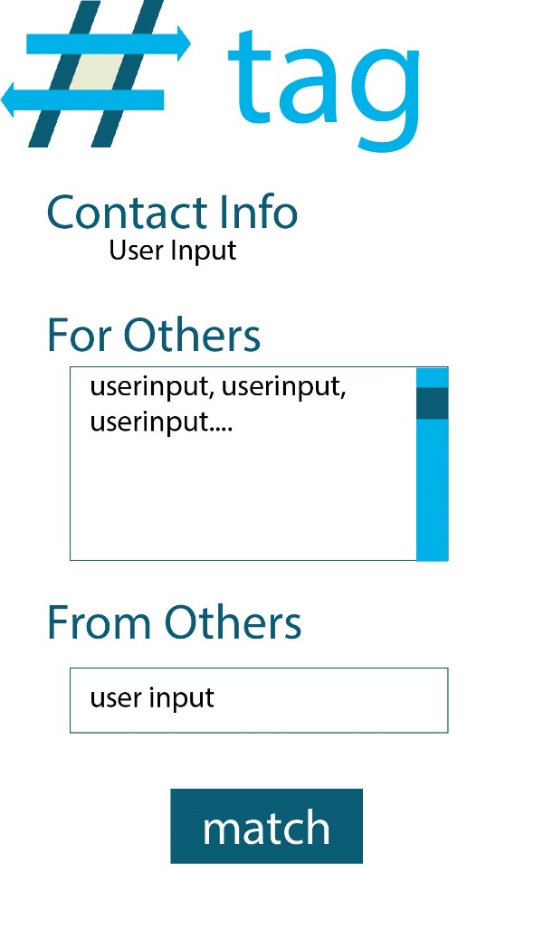
Here they see a summary of what info they have provided. For release 1 the search box and match button wont work since there is no cloud database yet.
The “User Summary Page”

